Slide 1
A Framework-Based Approach for Measuring Quantitatively Explainability Models in the Data Analysis Chain of Machine Learning when Detecting IoT Cyberattacks
Presentation for EPITA Summer Days
1 July 2023
Amani Abou Rida^{1,3} , Rabih Amhaz^{1,2}, Pierre Parrend^{1,3}
¹ICube (Laboratoire des sciences de l’ingénieur, de l’informatique et de l’imagerie), UMR 7357, Université de Strasbourg, 67000 Strasbourg, CNRS, France,
²ECAM Strasbourg-Europe, 67300 Schiltigheim, France,
³EPITA, 5, Rue Gustave Adolphe Hirn, 67000 Strasbourg, France
Notes:
Hello everyone, my name is Amani a 3rd year phd student at university of Strasbourg and EPITA and I'm excited to share with you my work which is supervised by dr rabih amhaz and prof pierre parrend
Well if have you ever wondered how to evaluate the effectiveness of explainability models quantitively when detecting cyberattacks in IoT data?
Then you're in the right place! In this presentation, I'll show you how to quantitively measure explainability models in the data analysis chain with the right metrics according to Explainability framework.

Slide 2
IoT Cyberattacks
Notes:
As we all know, we are living in an age where technology has advanced rapidly, and we are surrounded by smart devices that make our lives easier and more connected than ever before.
With the increasing use of IoT devices, there is also a rise in the number of security threats associated with them. Attackers can exploit vulnerabilities in IoT devices and use them to launch cyber attacks, steal data, or cause other types of damage.

Slide 3
ML for Cyberattack detection in IoT data
Efficiently process and analyze large volumes of IoT data
Ensure the security and privacy of sensitive information transmitted between connected devices
Identify patterns and anomalies in IoT data
[SS20] Yash Shah and Shamik Sengupta. “A survey on Classification of Cyber-attacks on IoT and IIoT devices”. In: 2020 11th IEEE Annual Ubiquitous Computing, Electronics & Mobile Communication Conference (UEMCON). IEEE. 2020, pp. 0406–0413.
Notes:
Machine learning plays a crucial role in detecting and preventing cyberattacks in IoT data. It has the ability to efficiently process and analyze large volumes of IoT data, which is critical in ensuring the security and privacy of sensitive information transmitted between connected devices and it helps to identify patterns and anomalies in IoT data.

Slide 4
Information Theft cyberattacks: keylogging and Data Exfiltration
MITRE ATT&CK®
Number of inbound connections per source IP and average rate per protocol per source IP are high
Initial Access (External Remote Service)
Lateral movement (Exploitation of remote service)
Collection (keylogging)
MITRE ATT&CK®
Transmitted packets is high from a specific destination port while having unfamiliar source port
Initial Access (External Remote Service)
Lateral movement (Exploitation of remote service)
Collection (Data from info repository)
Exfiltration (over alternative protocol TCP)
Notes:
Let's delve into the realm of information theft cyberattacks, specifically focusing on two prevalent techniques: data exfiltration and keylogging. Both techniques typically involve gaining unauthorized access to a remote service by exploiting IoT device vulnerabilities.
In keylogging attacks, the attacker captures keystrokes to gather sensitive information, such as login credentials. Notably, high numbers of inbound connections per source IP and an elevated average rate per protocol per source IP are indicative of keylogging activities.
On the other hand, data exfiltration involves the collection of sensitive data from an information repository, followed by its transmission using alternative protocols like TCP. During this process, we often observe a substantial volume of transmitted packets from a specific destination port, alongside unfamiliar source ports.
Understanding the patterns and indicators associated with these information theft techniques is crucial for timely detection and effective response. However, to gain deeper insights and enhance our understanding, explainability becomes paramount in the detection process.

Slide 5
Why do we need Explainability for ML when detecting Cyberattacks? What is the challenge?
WHY?
ML Model
The security team needs to be able to trust the explanations provided by the ML algorithm to make informed decisions and determine the appropriate course of action.
WHY?
AI is magic?
Notes:
Now, consider an information security analyst employing machine learning to detect attacks. When an ML algorithm triggers an alert for an unfamiliar attack, such as an information theft attack, the security team faces the challenge of understanding why the alert was triggered. A proficient manager would seek to identify the specific features or patterns that the algorithm detected, whether they indicate data exfiltration or keylogging. These features could be related to transmitted packets or network connections. Additionally, if the manager consults a data scientist, they would emphasize the importance of accuracy in detecting attacks without the reason behind these attacks.
However, an additional challenge arises in establishing trust in the explanations provided by the ML algorithm. The security team relies on these explanations to make well-informed decisions and determine the appropriate course of action. This highlights the criticality of explainability, as it enables the team to understand the reasoning behind the ML algorithm's alerts and fosters confidence in its outputs.

Slide 6
Artifacts of explainable ai (xai)
[Arr+20] Alejandro Barredo Arrieta et al. “Explainable Artificial Intelligence (XAI): Concepts, taxonomies, opportunities and challenges toward responsible AI”. In: Information fusion 58 (2020), pp. 82–115.
What is Explainability? “Given an audience, an explainable Artificial Intelligence model produces details or reasons to make its functioning clear or easy to understand”
Explainable AI (XAI)
Data
Model
Output
Interface
Human
Traceability
Understandability
Comprehensibility
Interface Explainability (Elucidation)
Interpretability
Ability to trace and understand the reasoning behind the decisions made by a model based on the data.
It denotes the characteristic of a model to make a human understand its function without any need for explaining its internal
structure
Ability of a learning algorithm to represent its learned knowledge in a human understandable way
Interface Explainability is a bridge between humans and a decision maker, serving as a faithful representation of the decision maker while remaining understandable to humans.
Capability of a model to explain its meaning in a manner that is easily understandable to a human
Notes:
What is Explainability in ML “Given an audience, an explainable Artificial Intelligence model produces details or reasons to make its functioning clear or easy to understand”
They developed 5 main artifacts for achieving explainability in the data analysis chain: \textbf{Traceability} the ability to trace and understand the data in the decision-making processes, \textbf{Understandability} the characteristic of a model to make a human understand its function, \textbf{Comprehensibility} the ability of an algorithm to represent its learned knowledge in a human understandable way , \textbf{Elucidation of user interface} provides a clear and understandable explanations for decisions to its users , and finally \textbf{Interpretability} the ability of providing a meaning for a model in terms understandable and shareable by human

Slide 7
Interface explainability models: Relevance features scores
Explainable AI (XAI)
Data
Model
Output
Interface
Human
Feature Importance
(FI) [AI19b]
Permutation Feature Importance
(PFI) [HMZ21]
Local Interpretable Model-agnostic Explanations
(LIME) [RSG16]
SHapley Additive exPlanations
(SHAP) [LL17]
Traceability
Understandability
Comprehensibility
Interface Explainability (Elucidation)
Interpretability
(Relevance features scores)
[Arr+20] Alejandro Barredo Arrieta et al. “Explainable Artificial Intelligence (XAI): Concepts, taxonomies, opportunities and challenges toward responsible AI”. In: Information fusion 58 (2020), pp. 82–115.
Notes:
One of the artifacts for explainability that we focused on in our research is interface explainability. It enhances the transparency of complex models by providing insights into their decision-making processes.
Specifically, we used four different algorithms for understanding the input features: Feature Importance (FI), Permutation Feature Importance (PFI), Local Interpretable Model-Agnostic Explanations (LIME), and SHapley Additive exPlanations (SHAP). These algorithms allowed us to better understand which features were most important in predicting different types of cyber attacks.

Slide 8
Explanation Properties
Feature Importance
(FI)
Permutation Feature Importance
(PFI)
Local Interpretable Model-agnostic Explanations
(LIME)
SHapley Additive exPlanations
(SHAP)
Explainable AI (XAI)
Data
Model
Output
Interface
Human
Traceability
Understandability
Comprehensibility
Interface Explainability (Elucidation)
Interpretability
Artifacts
Explanation properties
Explanation Robustness
Explanation Faithfulness
Explanation Performance
Explanation Reliance and Trust
Explanation Goodness and Satisfaction
Similar inputs or variations in data do not result in drastic changes in the explanations [Alvarez18].
Accurately represents the true reasoning process of a model, maintaining consistency between the explanation and the internal workings of the ML model [Kulesza13] .
Assessment and measurement for evaluating the ability to accurately classify outputs
[carvalho2019machine].
Level of user confidence in the provided explanations to understand the reasoning behind output predictions [Arr+20]
User perception of the clarity of the explanations contributing to higher satisfaction in the models [markus2021role]
Notes:
In our research, we have related the explanation properties to the framework proposed by Arrieta. By considering these properties, we were able to evaluate how well the explainability models fulfill the requirements of providing robustness, faithfulness, performance, reliance and trust, and satisfaction.
Explanation Robustness is closely connected to the concept of traceability, ensuring that similar inputs or variations in data do not result in drastic changes in the generated explanations.
Explanation Faithfulness is tied to the attribute of understandability, as it represents the ability of the explanations to accurately reflect the true reasoning process of the machine learning model. It emphasizes the importance of maintaining consistency between the explanations and the internal workings of the model.
Explanation Performance is associated with the comprehensibility of the output, referring to the assessment and measurement of the model's ability to accurately classify and predict outputs. It focuses on evaluating the accuracy of the explanations.
Explanation Reliance and Trust are linked to interface explainability elucidation, which determines the level of user confidence in the provided explanations. The goal is to ensure that users can trust and rely on the explanations to understand the reasoning behind the output predictions.
Explanation Goodness and Satisfaction are connected to human interpretability. They reflect the user's perception of the clarity and understandability of the explanations, ultimately contributing to higher levels of satisfaction with the explainability models.

Slide 9
Metrics properties
[carvalho2019machine] Carvalho DV, Pereira EM, Cardoso JS. Machine learning interpretability: A survey on methods and metrics. Electronics. 2019 Jul 26;8(8):832.
Feature Importance
(FI)
Permutation Feature Importance
(PFI)
Local Interpretable Model-agnostic Explanations
(LIME)
SHapley Additive exPlanations
(SHAP)
Explainable AI (XAI)
Data
Model
Output
Interface
Human
Traceability
Understandability
Comprehensibility
Interface Explainability (Elucidation)
Interpretability
Artifacts
Explanation properties
Explanation Robustness
Explanation Faithfulness
Explanation Performance
Explanation Reliance and Trust
Explanation Goodness and Satisfaction
Metrics Properties
Stability
Consistency
Performance
Fidelity
Reliability
Efficiency
Clarity
How stable are the explanations provided by a model when there are slight variations in the data?
How similar and consistent are the explanations generated by different machine learning models that produce similar predictions?
Can the explanations accurately predict the output behavior by underlying Black box model?
What features helps in understanding the predictions of a black box model when using explainability models?
Which explainability model user can rely on?
Can the explainability models produce explanations that are understandable
within a finite and timeframe?
Are the explanations easily understandable and clear for human?
Notes:
In addition to the explainability framework proposed by Arrieta and to the explainability properties, we also explored various metrics properties from the state of the art that can help us evaluate the effectiveness of explainability models. By relating these metrics properties to our framework, we gain a comprehensive understanding of the different aspects of explainability and how they can be quantitatively measured. Let's delve into each metric and its connection to the framework:

Slide 10
Metrics Types: Existing Qualitative Metrics
Comparison | FI | PFI | LIME​​ | SHAP
Data used​​ | Trained model​​ | Trained model​​ | Any datapoint​​ | Any datapoint​​​​
Model types | Only trees​​ Model specific ​ | Only trees​​ Model agnostic ​ | Any​ Model agnostic ​​ | Different explainer's types​​ Model agnostic ​
Explainability Level​ | Global​​ | Global​​ | Local​​ | Global and Local​​
Explainability Type​ | feature importance, visualization​ | feature importance, visualization​ | Simplification, visualization​ | feature relevance, visualization​
Limitations​​ | ​ Computed on training set statistics and therefore do not reflect the ability of feature to be useful to make predictions that generalize to the test set (data)​ Unsuitable for linear models and for continuous features (only suitable for tree models) (ML model)​ ​ | Unsuitable to explain time series models or when there are strongly correlated features (data)​ Do not provide information on how the feature affects the model's predictions for specific instances or subsets of the data (global explanation) (data and output)​ Does not account for any interactions between features (feature relevance)​ | ​Does not provide a complete picture of the model's behavior for the entire dataset (local explanation) (data and output)​ Depends on the number of fake instances you generate and the kernel width you select this introduce inaccuracies and lead to a loss of information (data and output)​ | Cannot be used to make statements about changes in prediction for changes in the input (data and output)​ Difficult to compare explanations from different ml models (each model requires different type of explainer) (ML model)​ Large computational time because the training time grows exponentially with the number of features (output)​
Notes:
When it comes to evaluating the effectiveness of explainability models, we can utilize two types of metrics: qualitative and quantitative.
When comparing explainability models qualitatively, subjective assessments play a significant role. These assessments involve evaluating various aspects such as data, model type, explainability level, and explainability type, and we provide the limitation for each.
We saw that FI and PFI use trained data and considered as model specific since they work only on tree while LIME and SHAP use any data point and are model agnostic so they work on any model.
Moreover, FI and PFI provides global explainability level for the whole data while LIME provides local level for specific instances and SHAP can provide both global and local.

Slide 11
Metrics types: Existing quantitative Metrics
Metrics properties | Accuracy | Unbalanced Accuracy | MCC | F1 score | Precision | Recall | Impurity feature score | Permutation feature score | Lime values | Shaply values
Stability
Consistency
Performance
Fidelity
Reliability
Efficiency
Clarity
Notes:
Quantitative evaluation of explainability models provides a more objective approach to assessing their effectiveness. We prepared a table that highlights the key quantitative metrics and their corresponding links to the metrics properties and framework.
Performance quantitave metrics includes: precision, recall, accuracy, f1 score, mcc
Fidelitity quantitave scores includes: relative importance scores derived from FI, PFI, LIME and SHAP.
However, it's important to note that other metrics properties within the framework currently lack quantitative measures for evaluating explainability. This highlights the need for further research and the opportunity to propose new quantitative metrics that align with these properties.

Slide 12
Research question
Within the framework of explainability, what quantitative metrics can be proposed to measure the explainability of machine learning models when detecting IoT cyberattacks, considering the properties of explainability metrics?
Feature Importance
(FI)
Permutation Feature Importance
(PFI)
Local Interpretable Model-agnostic Explanations
(LIME)
SHapley Additive exPlanations
(SHAP)
Explainable AI (XAI)
Data
Model
Output
Interface
Human
Traceability
Understandability
Comprehensibility
Interface Explainability (Elucidation)
Interpretability
Artifacts
Explanation Robustness
Explanation Faithfulness
Explanation Performance
Explanation Reliance and Trust
Explanation Goodness and Satisfaction
Metrics Properties
Stability
Consistency
Performance
Fidelity
Reliability
Efficiency
Clarity
precision/ recall / Accuracy/ F1 score/ time prediction/Mcc/ AUPRC/unbalanced accuracy/ loss
Information gain (FI scores)
PFI scores
Lime scores
Shapely values
Existing Quantitative Metrics

Slide 13
Explanation Reliance and Trust - Reliability - Top-K , Correlation analysis, Distance Analysis
Feature Importance
(FI)
Permutation Feature Importance
(PFI)
Local Interpretable Model-agnostic Explanations
(LIME)
SHapley Additive exPlanations
(SHAP)
“Can you rely on these explanations to be correct when using different explainability models?”
Feature important scores
Correlation Analysis: Measures the similarity of feature scores generated by different explainability models
Formula:
Distance Analysis: Measures how much the feature importance scores differ between two models.
3 common features
1 common feature
4 common feature
Formula:
Top-k: Measures how similar the top k most important features are across all interface explainability models
Formula:
Notes:
Our first proposed metric is reliability.
So as we saw in previous slides that the interface explainability models will generate feature importance scores.
But which of them users can trust and rely on?

Slide 14
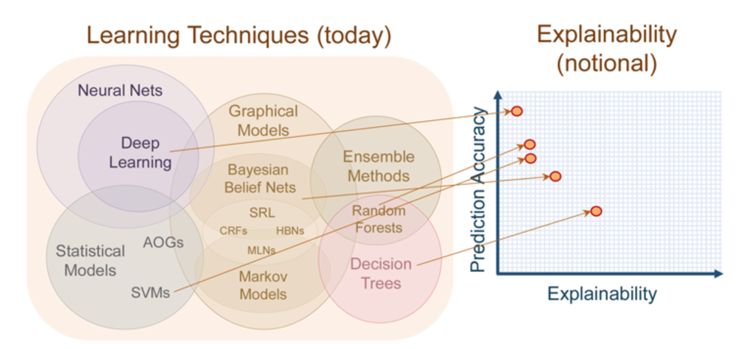
Explanation Reliance and Trust - Efficiency – Relative Time cost
“Can the explainability models produce explanations that are understandable
within a finite and timeframe?”
Definition: The relative time cost metric measures the time % it takes for an interface explainability model to generate explanations for cyber-attacks.
Tradeoff Explainability (Relative Time cost), Performance (accuracy), and Time Performance.
Accuracy
Objective: Balance the need for quick explanations with the need for accurate and comprehensive explanations.
Explainability ??
Formula:
Explainability Time cost %
Performance Time cost %
Notes:
Our second metric is latency.
Most of the researchers have agreed that there is always a tradeoff between accuracy of prediction and explainability.
But how can we measure the explainability to plot this tradeoff?
In our work we were able to plot a 3D representation of the tradeoff between explainability measures by effieciency, performance which is measure by accuracy and prediction time.

Slide 15
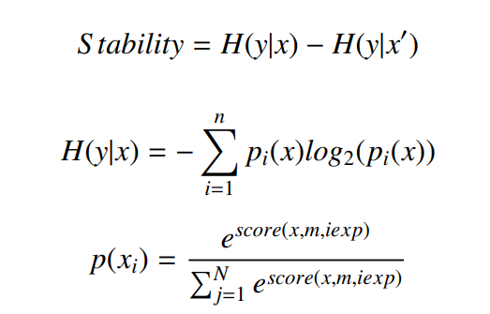
Explanation Robustness - Stability – entropy analysis
Feature Importance
(FI)
Permutation Feature Importance
(PFI)
Local Interpretable Model-agnostic Explanations
(LIME)
SHapley Additive exPlanations
(SHAP)
“How well do the explanations (feature scores) handle variations in input data while maintaining stability?”
Entropy Analysis: Measure the uncertainty or randomness of explainability model when using two different datasets sizes or changing number of classes in the dataset.
Formula:

Slide 16
Explanation Faithfulness - consistency – correlation analysis
“Does similar performance between machine learning models give similar explanations?”
Correlation Analysis: Measure the similarity of feature scores between similar ML performance .
Formula:

Slide 17
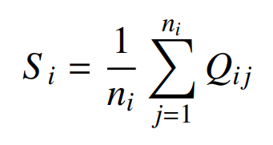
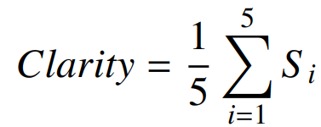
Explanation Goodness and Satisfaction - Clarity – clarity score
Data
Urgency
Experts
“How satisfied are humans with the clarity of the explanations provided by various explainability models?”
Audience
Impact
Clarity score: Measure the interpretability of human by asking several questions according to several contextual factors.
Formula:

Slide 18
Framework for Explainability – Methodology Expectation
Feature Importance
(FI)
Permutation Feature Importance
(PFI)
Local Interpretable Model-agnostic Explanations
(LIME)
SHapley Additive exPlanations
(SHAP)
Explainable AI (XAI)
Data
Model
Output
Interface
Human
Traceability
Understandability
Comprehensibility
Interface Explainability (Elucidation)
Interpretability
Artifacts
Explanation properties
Explanation Robustness
Explanation Faithfulness
Explanation Performance
Explanation Reliance and Trust
Explanation Goodness and Satisfaction
Metrics Properties
Stability
Consistency
Performance
Fidelity
Reliability
Efficiency
Clarity
Quantitative Metrics
Entropy Analysis
Correlation Analysis
precision/ recall / Accuracy/ F1 score/ time prediction/Mcc/ AUPRC/unbalanced accuracy/ loss
Information gain (FI scores)
PFI scores
Lime scores
Shapely values
Top-k
Distance Analysis
Correlation Analysis
Relative time cost
Clarity score
Notes:
Our methodology for evaluating the explainability of machine learning models when detecting IoT cyberattacks involves going through the different phases of the data analysis chain and assessing explainability based on the framework we have established. Our objective is to achieve quantitative measures for each phase, enabling users to make informed choices regarding the best explainability model for their specific needs.

Slide 19
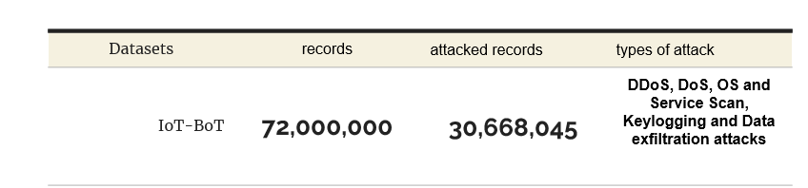
Implementation and datasets
Implementation
Datasets
We utilize Jupyter Notebook running on a Larry server to perform the required analyses.
We used IoT dataset created by the Cyber Security Research Group at the University of New South Wales [koroniotis2019towards]
HPE DL385 generation 10+
two AMD EPYC 7552 48-Core Processors
3 TB of RAM
[Boo+21] Tim M Booij et al. “ToN_IoT: The role of heterogeneity and the need for standardization of features and attack types in IoT network intrusion data sets”. In: IEEE Internet of Things Journal 9.1 (2021), pp. 485–496.
[Kor+19] Nickolaos Koroniotis et al. “Towards the development of realistic botnet dataset in the internet of things for network forensic analytics: Bot-iot dataset”. In: Future Generation Computer Systems 100 (2019), pp. 779–796.
[MS16] Nour Moustafa and Jill Slay. “The evaluation of Network Anomaly Detection Systems: Statistical analysis of the UNSW-NB15 data set and the comparison with the KDD99 data set”. In: Information Security Journal: A Global Perspective 25.1-3 (2016), pp. 18–31.
Notes:
For our research, we utilized Jupyter Notebook running on the Larry server to perform the required analyses.
Additionally, we used IoT datasets created by the Cyber Security Research Group at the University of New South Wales which contains information theft cyberattacks (key logging and data exfiltration)

Slide 20
Framework for Explainability – explanation performance
Feature Importance
(FI)
Permutation Feature Importance
(PFI)
Local Interpretable Model-agnostic Explanations
(LIME)
SHapley Additive exPlanations
(SHAP)
Explainable AI (XAI)
Data
Model
Output
Interface
Human
Traceability
Understandability
Comprehensibility
Interface Explainability (Elucidation)
Interpretability
Artifacts
Explanation properties
Explanation Robustness
Explanation Faithfulness
Explanation Performance
Explanation Reliance and Trust
Explanation Goodness and Satisfaction
Metrics Properties
Stability
Consistency
Performance
Fidelity
Reliability
Efficiency
Clarity
Quantitative Metrics
Entropy Analysis
Correlation Analysis
precision/ recall / Accuracy/ F1 score/ time prediction/Mcc/ AUPRC/unbalanced accuracy/ loss
Top-k
Distance Analysis
Correlation Analysis
Relative time cost
Clarity score
Information gain (FI scores)
PFI scores
Lime scores
Shapely values
”Can the performance give explanations on the output behavior by underlying Black box model?”
Notes:
One of the initial steps taken by the security team is to utilize machine learning models to detect Information theft cyberattacks and assess their performance. However, an important question arises: "Can the performance of these models provide explanations on the output behavior by the underlying black box model?"

Slide 21
Explanation Performance - Performance
CART strikes a balance between accuracy and computational time across both binary and multi-classification tasks for information theft.

Slide 22
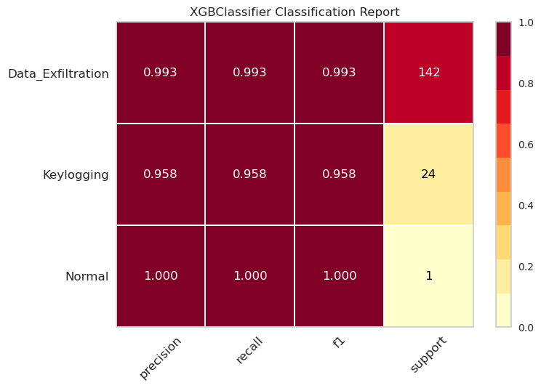
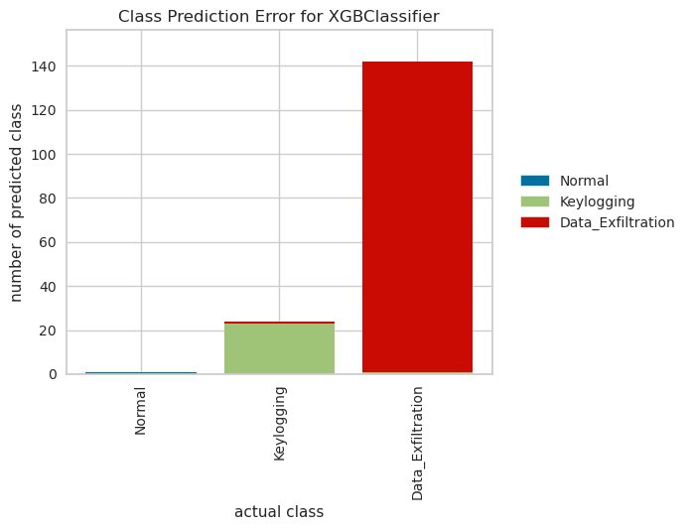
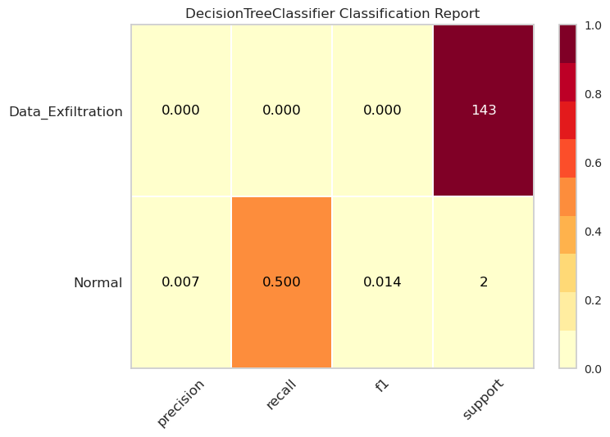
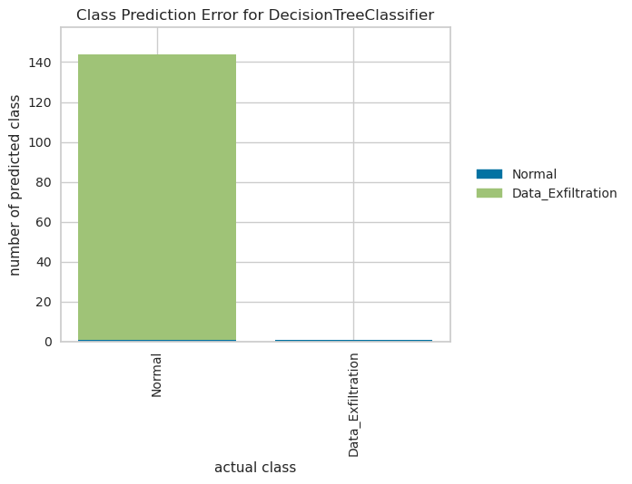
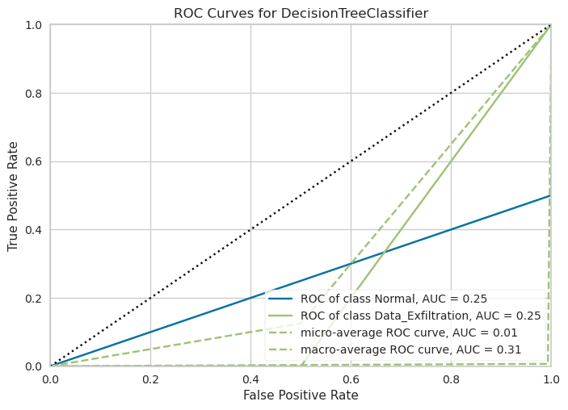
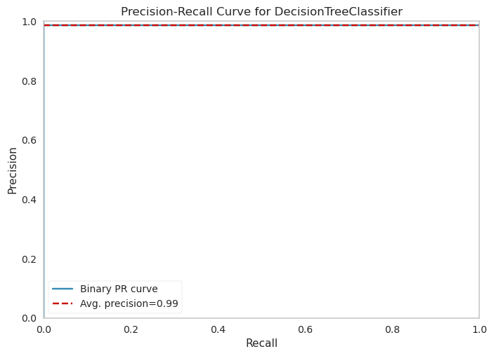
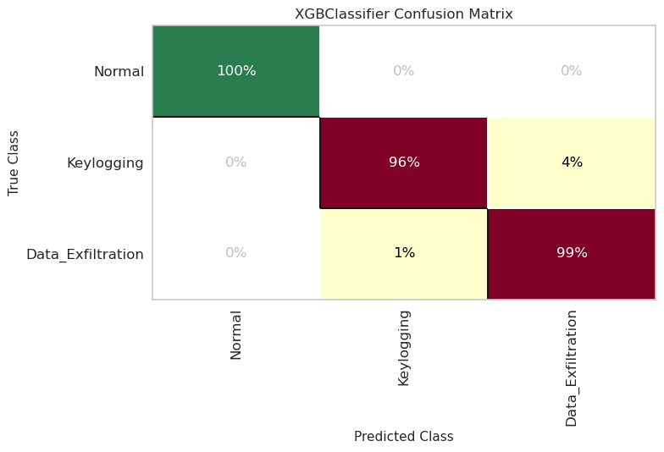
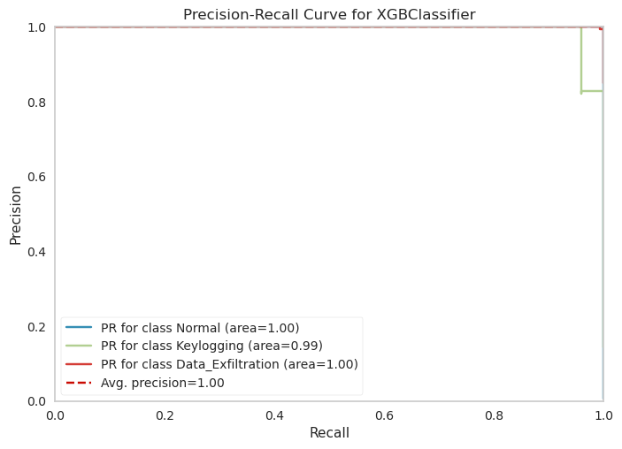
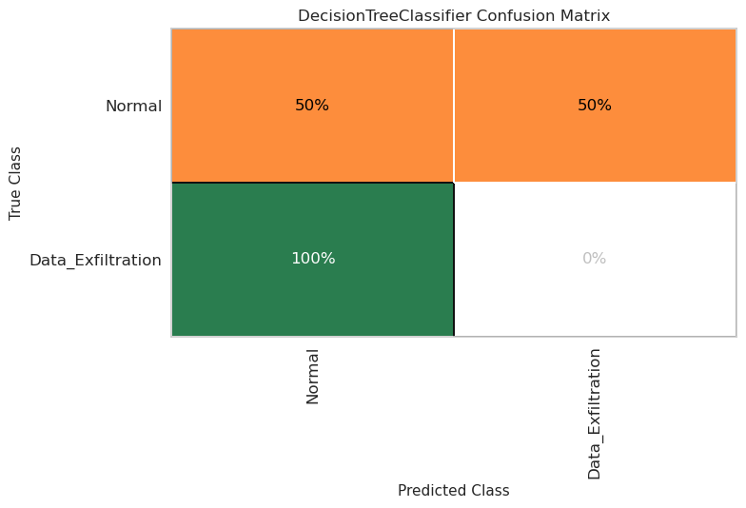
Explanation Performance – Performance Visualization
Multi classification for ‘Data Exfiltration’ and ‘keylogging’ using XGBoost
Binary classification for “Exfiltration” using CART

Slide 23
Conclusion for Explanation Reliance and Trust - Reliability
XGBoost excels in accurately predicting and classifying various types of information theft cyberattacks in multi-classification, while CART demonstrates effectiveness in distinguishing data exfiltration cyberattacks from non-exfiltration instances in binary classification. Overall, CART strikes a balance between accuracy and computational time across both binary and multi-classification tasks for information theft.
Visualization of the CM, CPE, CR, PRC, and ROC provide informative metrics and graphical representations of the model's performance
Security team need to understand the reason behind this classification to gain further insights into the model's decision-making process and influential features by using Interface explainability models.

Slide 24
Framework for Explainability – explanation Reliance and trust
Feature Importance
(FI)
Permutation Feature Importance
(PFI)
Local Interpretable Model-agnostic Explanations
(LIME)
SHapley Additive exPlanations
(SHAP)
Explainable AI (XAI)
Traceability
Understandability
Comprehensibility
Interface Explainability (Elucidation)
Interpretability
Artifacts
Explanation properties
Explanation Robustness
Explanation Faithfulness
Explanation Performance
Explanation Reliance and Trust
Explanation Goodness and Satisfaction
Metrics Properties
Stability
Consistency
Performance
Fidelity
Reliability
Efficiency
Clarity
Quantitative Metrics
Entropy Analysis
Correlation Analysis
precision/ recall / Accuracy/ F1 score/ time prediction/Mcc/ AUPRC/unbalanced accuracy/ loss
Top-k
Distance Analysis
Correlation Analysis
Relative time cost
Clarity score
Information gain (FI scores)
PFI scores
Lime scores
Shapely values
“Which features play a significant role in the detection process when utilizing explainability models?”
Notes:
The second step that security team needs to address is “Which features play a significant role in the detection process when utilizing explainability models?”

Slide 25
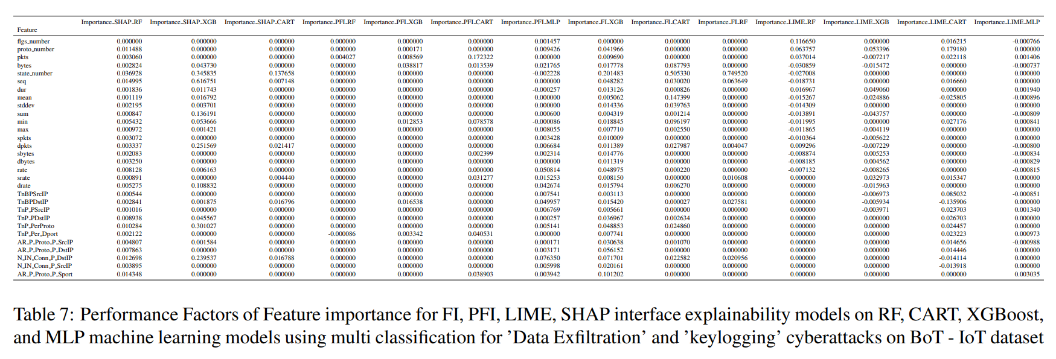
Explanation Reliance and Trust - Fidelity- Multi classification for Exfiltration and keylogging using XGBoost

Slide 26
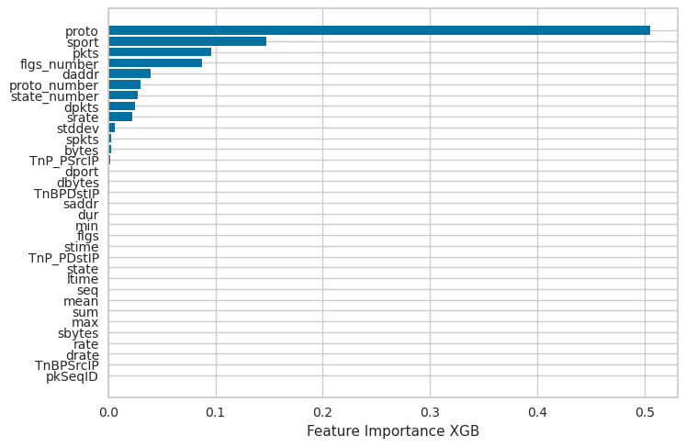
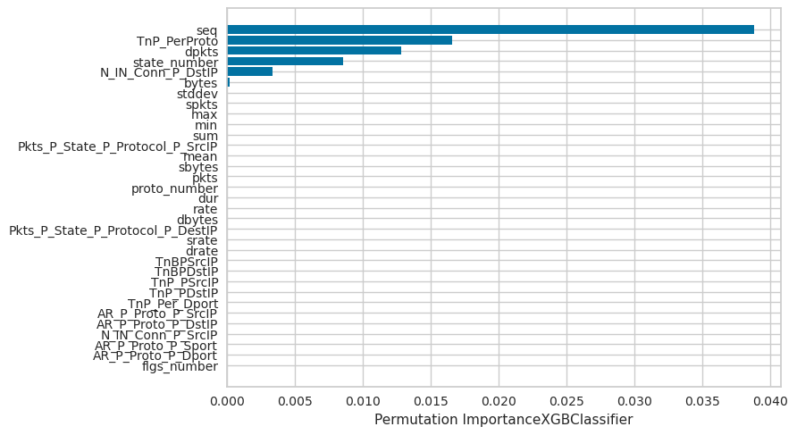
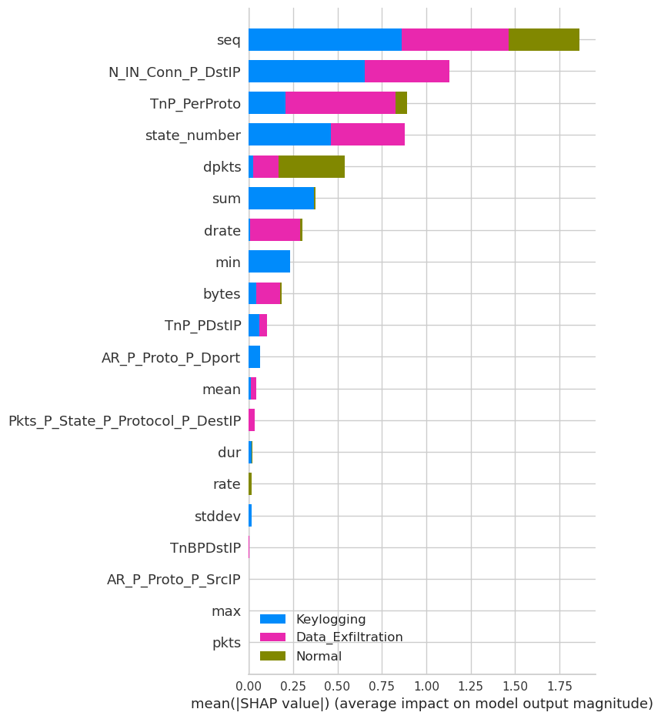
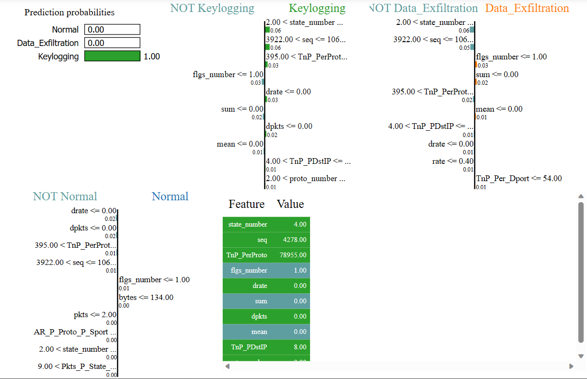
Explanation Reliance and Trust - Fidelity- Multi classification for Exfiltration and keylogging using XGBoost

Slide 27
Conclusion for Explanation Reliance and Trust - Fidelity
Interface explainability models highlighted feature importance scores in multi-classification of information theft, LIME provided feature values for different classification scenarios, and SHAP revealed the importance and impact of features on each attack type.
Security team observed that each model provided different feature importance scores, highlighting the challenge of comparing and understanding the differences and similarities between the explanations generated by these models.

Slide 28
Framework for Explainability – explanation Reliance and trust
Feature Importance
(FI)
Permutation Feature Importance
(PFI)
Local Interpretable Model-agnostic Explanations
(LIME)
SHapley Additive exPlanations
(SHAP)
Explainable AI (XAI)
Traceability
Understandability
Comprehensibility
Interface Explainability (Elucidation)
Interpretability
Artifacts
Explanation properties
Explanation Robustness
Explanation Faithfulness
Explanation Performance
Explanation Reliance and Trust
Explanation Goodness and Satisfaction
Metrics Properties
Stability
Consistency
Performance
Fidelity
Reliability
Efficiency
Clarity
Quantitative Metrics
Entropy Analysis
Correlation Analysis
precision/ recall / Accuracy/ F1 score/ time prediction/Mcc/ AUPRC/unbalanced accuracy/ loss
Top-k
Distance Analysis
Correlation Analysis
Relative time cost
Clarity score
Information gain (FI scores)
PFI scores
Lime scores
Shapely values
”Can you rely on these explanations to be correct when using different explainability models?”

Slide 29
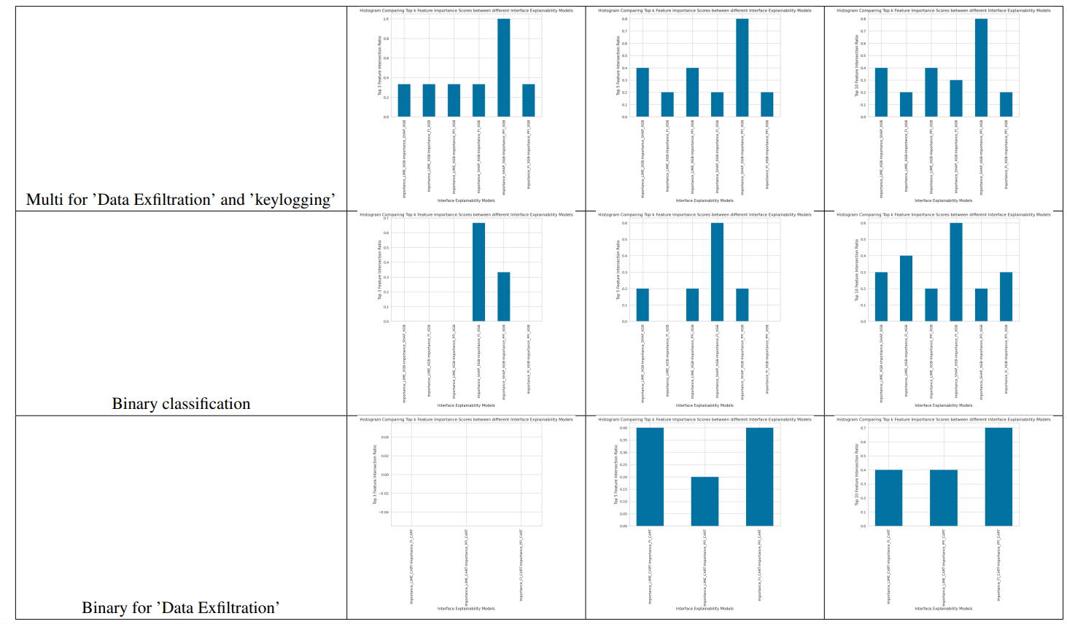
Explanation Reliance and Trust - Reliability - Topk
SHAP and PFI have most common top features
SHAP and FI have most common top features
PFI and FI have most common top features

Slide 30
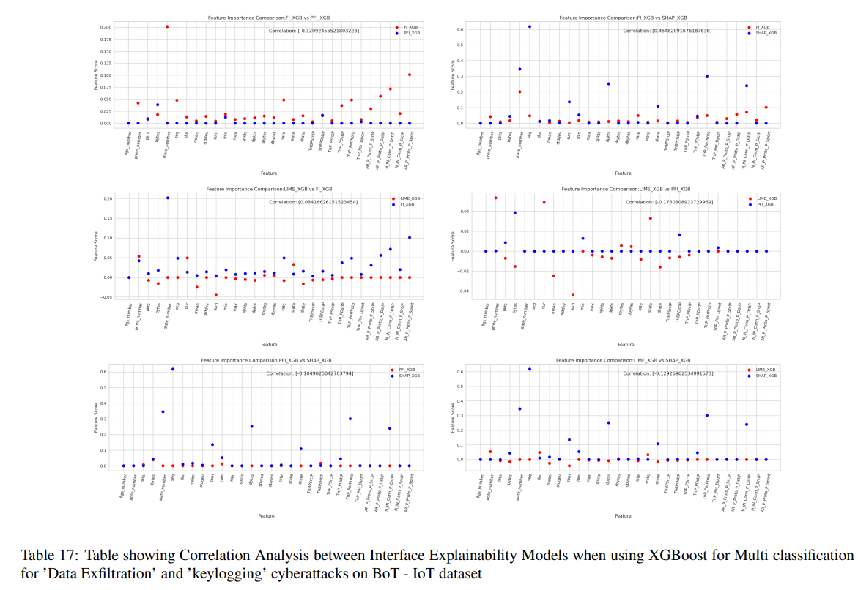
Explanation Reliance and Trust - Reliability – Correlation Analysis
SHAP and FI have most similar features values

Slide 31
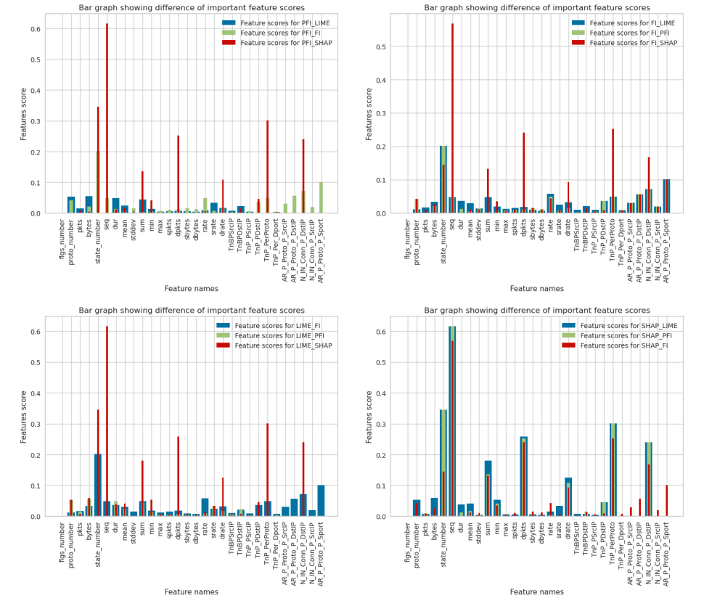
Explanation Reliance and Trust - Reliability – Distance Analysis
SHAP has less different values between other explainability models

Slide 32
Conclusion for Explanation Reliance and Trust - Reliability
In evaluating the reliability of Interface explainability models, we observed that SHAP demonstrated better similarity and less divergence compared to other explainability models. This suggests that users can rely on SHAP for generating consistent and reliable explanations.
Security team needs to know whether the explanations were generated quickly enough to strike a balance between the need for accurate performance and timely delivery of explanations.

Slide 33
Framework for Explainability – explanation Reliance and trust
Feature Importance
(FI)
Permutation Feature Importance
(PFI)
Local Interpretable Model-agnostic Explanations
(LIME)
SHapley Additive exPlanations
(SHAP)
Explainable AI (XAI)
Traceability
Understandability
Comprehensibility
Interface Explainability (Elucidation)
Interpretability
Artifacts
Explanation properties
Explanation Robustness
Explanation Faithfulness
Explanation Performance
Explanation Reliance and Trust
Explanation Goodness and Satisfaction
Metrics Properties
Stability
Consistency
Performance
Fidelity
Reliability
Efficiency
Clarity
Quantitative Metrics
Entropy Analysis
Correlation Analysis
precision/ recall / Accuracy/ F1 score/ time prediction/Mcc/ AUPRC/unbalanced accuracy/ loss
Top-k
Distance Analysis
Correlation Analysis
Relative time cost
Clarity score
Information gain (FI scores)
PFI scores
Lime scores
Shapely values
“Can the explainability models produce explanations that are understandable within a finite and timeframe?”

Slide 34
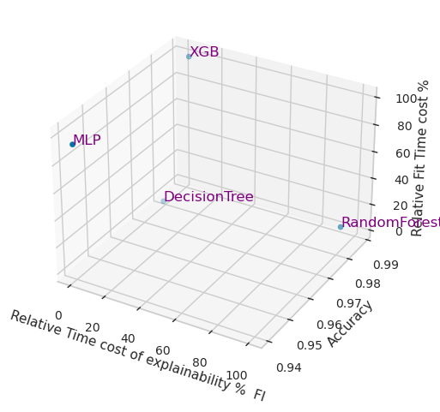
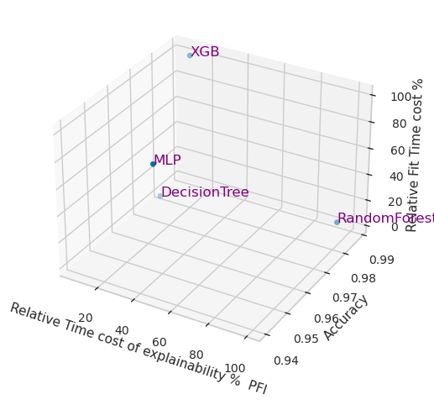
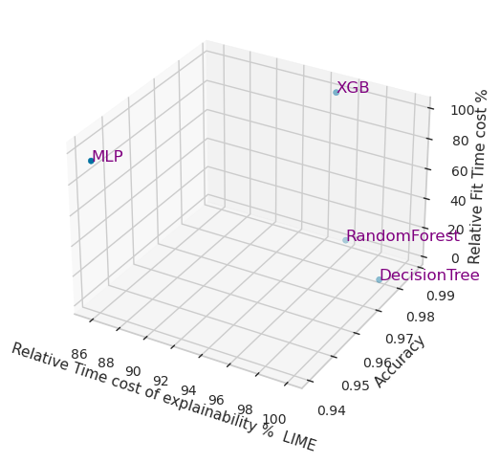
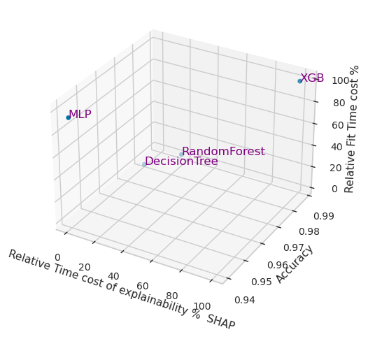
Explanation Reliance and Trust - Efficiency
FI interface explainability model is quicker in generating explanations for XGB classifier

Slide 35
Conclusion – Explanation Reliance and trust - Efficiency
FI (Feature Importance) method emerged as the most efficient in terms of time relevance cost, offering a favorable balance between accurate performance and timely delivery of explanations.
A new challenge arises for the security team in assessing the stability of data and its potential impact on the robustness of explanations, as uncertainties or inconsistencies in data stability may introduce variability in explainability models.

Slide 36
Framework for Explainability – Explanation Robustness
Feature Importance
(FI)
Permutation Feature Importance
(PFI)
Local Interpretable Model-agnostic Explanations
(LIME)
SHapley Additive exPlanations
(SHAP)
Explainable AI (XAI)
Traceability
Understandability
Comprehensibility
Interface Explainability (Elucidation)
Interpretability
Artifacts
Explanation properties
Explanation Robustness
Explanation Faithfulness
Explanation Performance
Explanation Reliance and Trust
Explanation Goodness and Satisfaction
Metrics Properties
Stability
Consistency
Performance
Fidelity
Reliability
Efficiency
Clarity
Quantitative Metrics
Entropy Analysis
Correlation Analysis
precision/ recall / Accuracy/ F1 score/ time prediction/Mcc/ AUPRC/unbalanced accuracy/ loss
Top-k
Distance Analysis
Correlation Analysis
Relative time cost
Clarity score
Information gain (FI scores)
PFI scores
Lime scores
Shapely values
”How well do the explanations handle variations in input data while maintaining stability?”

Slide 37
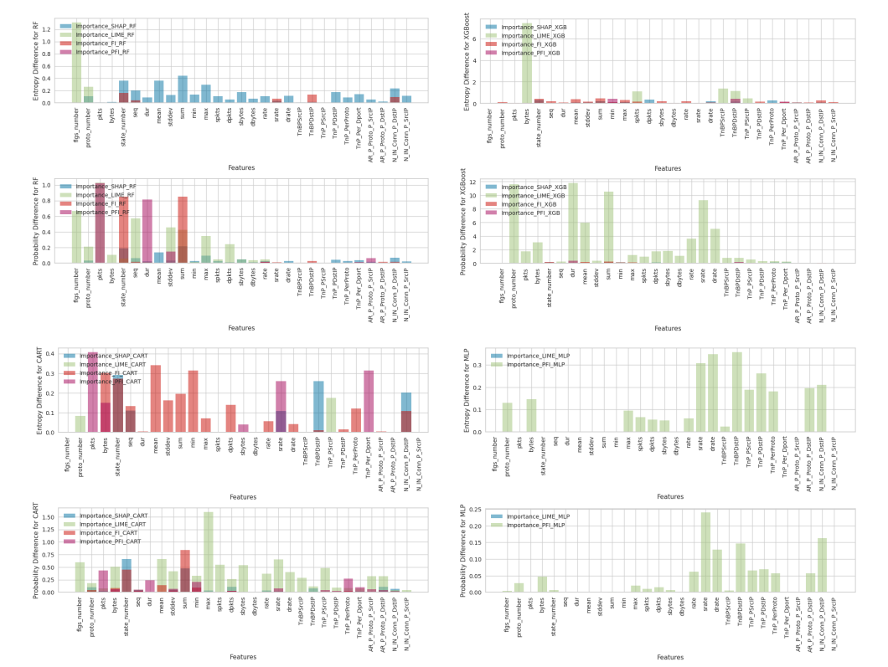
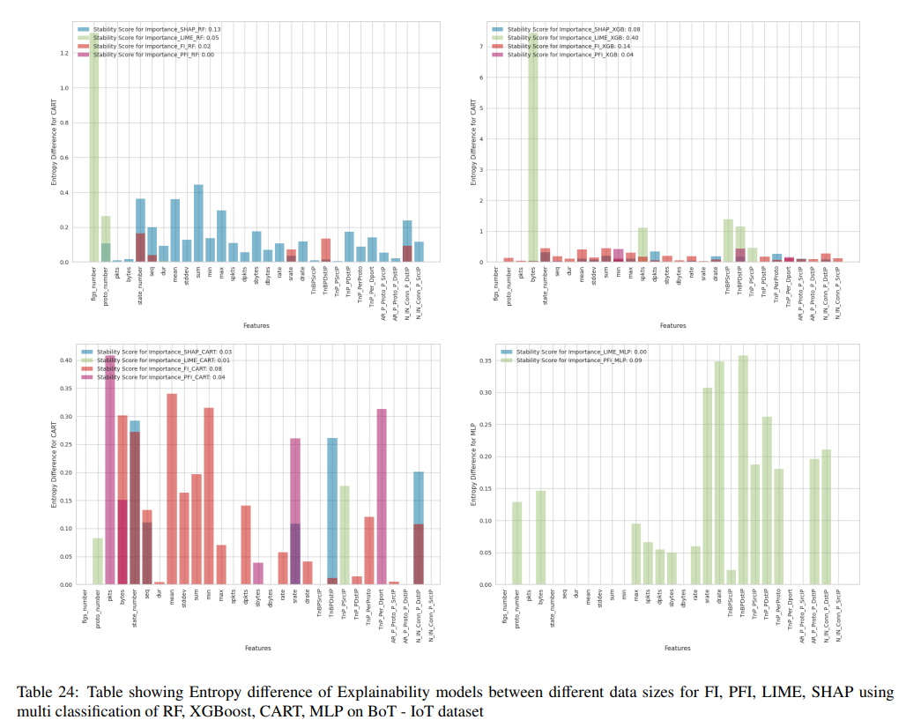
Explanation Robustness - Stability
PFI is more stable when changing size od data and number of classes

Slide 38
Conclusion – Explanation robustness - stability
After observing the variation in data size and the number of classes, it was found that PFI (Permutation Feature Importance) exhibited greater stability compared to other explainability models. It was less affected by changes in data size and the number of classes, indicating its robustness and stability.
A new challenge arises for security team in understanding the impact of different ML (Machine Learning) models on explainability

Slide 39
Framework for Explainability – explanation faithfulness
Feature Importance
(FI)
Permutation Feature Importance
(PFI)
Local Interpretable Model-agnostic Explanations
(LIME)
SHapley Additive exPlanations
(SHAP)
Explainable AI (XAI)
Traceability
Understandability
Comprehensibility
Interface Explainability (Elucidation)
Interpretability
Artifacts
Explanation properties
Explanation Robustness
Explanation Faithfulness
Explanation Performance
Explanation Reliance and Trust
Explanation Goodness and Satisfaction
Metrics Properties
Stability
Consistency
Performance
Fidelity
Reliability
Efficiency
Clarity
Quantitative Metrics
Entropy Analysis
Correlation Analysis
precision/ recall / Accuracy/ F1 score/ time prediction/Mcc/ AUPRC/unbalanced accuracy/ loss
Top-k
Distance Analysis
Correlation Analysis
Relative time cost
Clarity score
Information gain (FI scores)
PFI scores
Lime scores
Shapely values
“Does similar performance between machine learning models give similar explanations?”

Slide 40
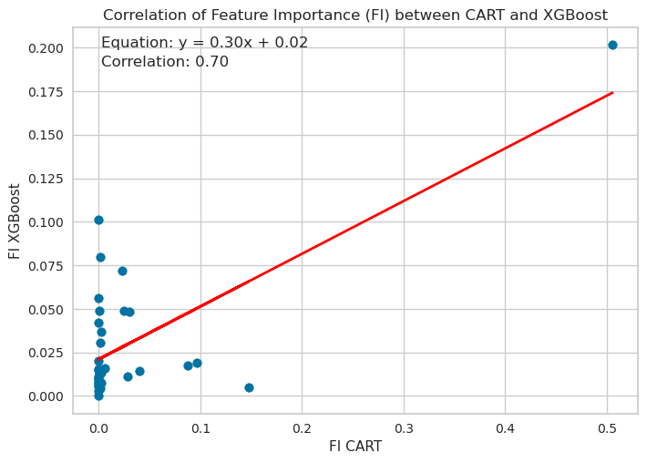
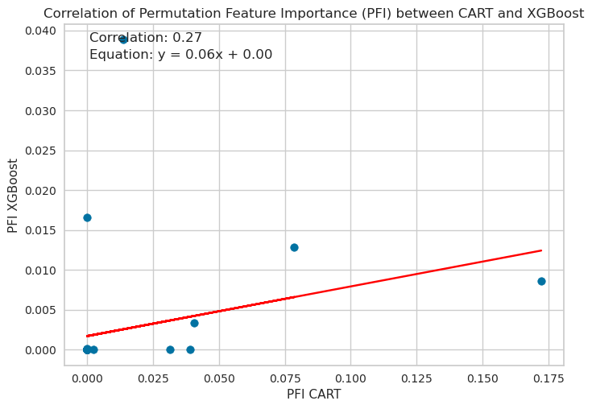
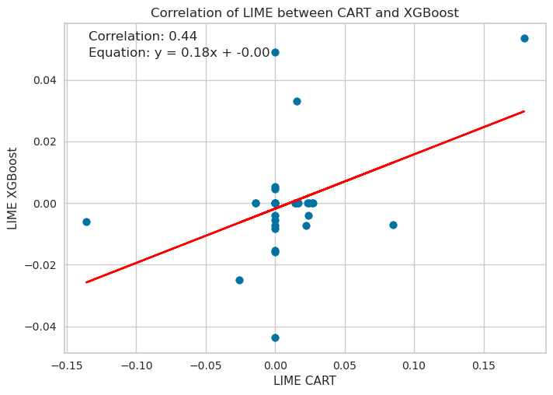
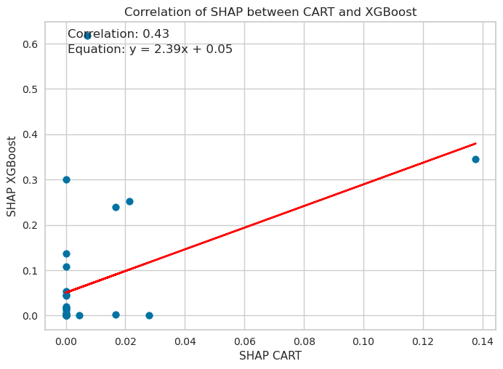
Explanation Faithfulness - consistency
FI shows better consistency since XGBoost and CART shows similar explanations when applying explainability model

Slide 41
Conclusion – Explanation faithfulness - consistency
Our findings demonstrate that FI (Feature Importance) exhibits consistency between explanations and accuracy, as observed through similar feature scores between FI XGBoost and FI CART, highlighting the faithfulness of the explanations.
There is a challenge on selecting a suitable explainability model for security team when considering the potential influence of different variations in the data analysis chain on the choice and perception of a "good" explanation.

Slide 42
Framework for Explainability - Explanation Goodness and Satisfaction
Feature Importance
(FI)
Permutation Feature Importance
(PFI)
Local Interpretable Model-agnostic Explanations
(LIME)
SHapley Additive exPlanations
(SHAP)
Explainable AI (XAI)
Traceability
Understandability
Comprehensibility
Interface Explainability (Elucidation)
Interpretability
Artifacts
Explanation properties
Explanation Robustness
Explanation Faithfulness
Explanation Performance
Explanation Reliance and Trust
Explanation Goodness and Satisfaction
Metrics Properties
Stability
Consistency
Performance
Fidelity
Reliability
Efficiency
Clarity
Quantitative Metrics
Entropy Analysis
Correlation Analysis
precision/ recall / Accuracy/ F1 score/ time prediction/Mcc/ AUPRC/unbalanced accuracy/ loss
Top-k
Distance Analysis
Correlation Analysis
Relative time cost
Clarity score
Information gain (FI scores)
PFI scores
Lime scores
Shapely values
"How satisfied are humans with the clarity of the explanations provided by various explainability models?"

Slide 43
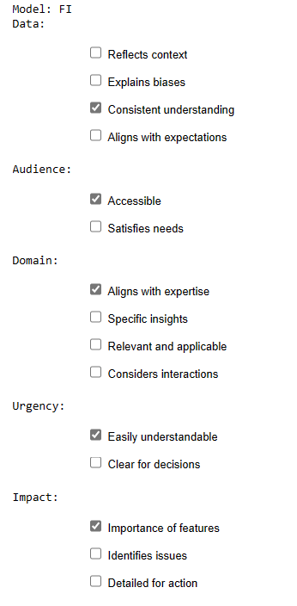
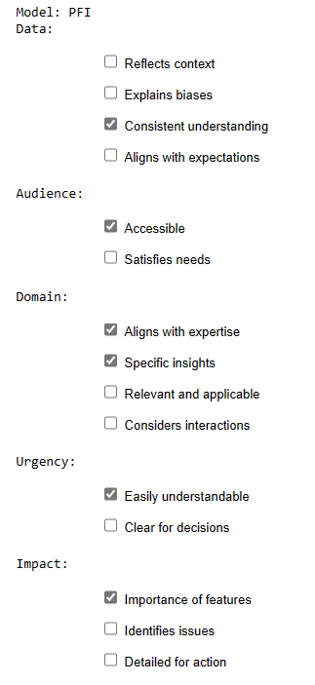
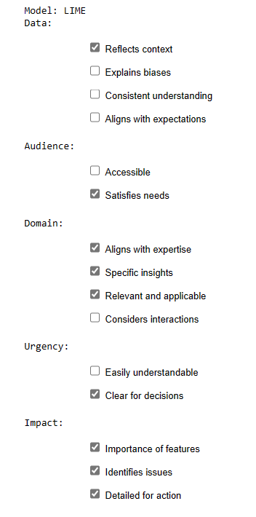
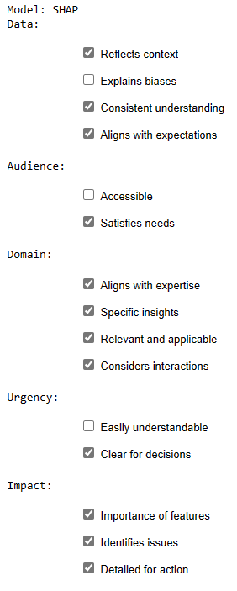
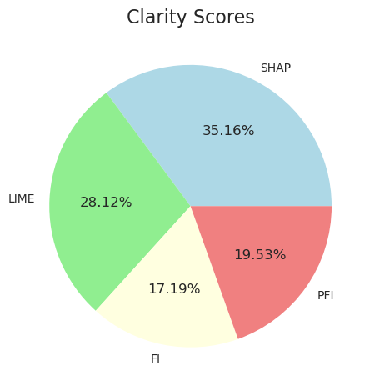
Explanation Goodness and satisfaction - Clarity

Slide 44
Conclusion – Explanation Goodness and satisfaction - clarity
The utilization of dashboard and clarity score enables the attainment of clarity and satisfaction in selecting the appropriate explainability model based on diverse interpretability factors, enhancing the overall interpretability for human users.

Slide 45
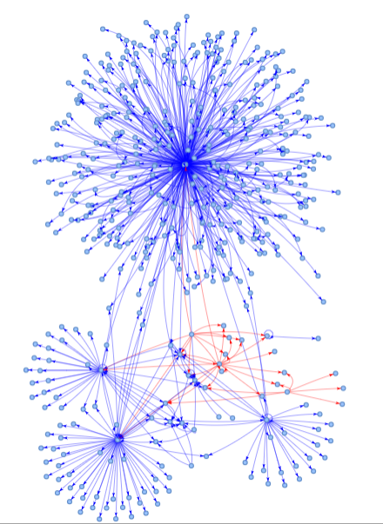
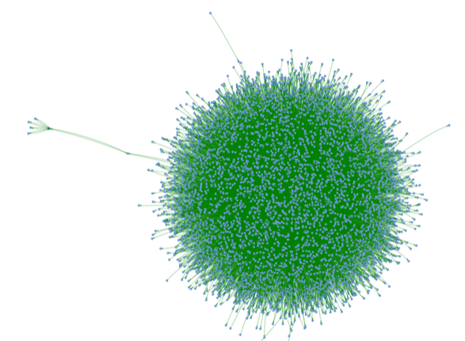
Conclusion and perspective
In conclusion, our research comprehensively evaluated the quantitative metrics within the framework of explainability for measuring the explainability of machine learning models in detecting IoT cyberattacks. By analyzing explainability models across the data analysis chain and considering the properties of explainability metrics, we achieved a thorough assessment of the explanation properties and their suitability in providing interpretable insights for understanding and detecting IoT cyberattacks.
Perspective:
Ton-IoT
53,726,220 records
BoT-IoT
72.000.000 records
Datasets
Unsw-nb15
two million and 540,044
records
Different IoT datasets and different IoT cyberattacks
Extend Explainability Framework to Graph Learning

Slide 46
References
[Alvarez18] Alvarez-Melis D, Jaakkola TS. On the robustness of interpretability methods. arXiv preprint arXiv:1806.08049. 2018 Jun 21.
[Kulesza13] Kulesza, Todd, et al. "Too much, too little, or just right? Ways explanations impact end users' mental models." 2013 IEEE Symposium on visual languages and human centric computing. IEEE, 2013.
[carvalho2019machine] Carvalho DV, Pereira EM, Cardoso JS. Machine learning interpretability: A survey on methods and metrics. Electronics. 2019 Jul 26;8(8):832.
[markus2021role] Markus, Aniek F., Jan A. Kors, and Peter R. Rijnbeek. "The role of explainability in creating trustworthy artificial intelligence for health care: a comprehensive survey of the terminology, design choices, and evaluation strategies." Journal of Biomedical Informatics 113 (2021): 103655.
[SS20] Yash Shah and Shamik Sengupta. “A survey on Classification of Cyber-attacks on IoT and IIoT devices”. In: 2020 11th IEEE Annual Ubiquitous Computing, Electronics & Mobile Communication Conference (UEMCON). IEEE. 2020, pp. 0406–0413.
[Arr+20] Alejandro Barredo Arrieta et al. “Explainable Artificial Intelligence (XAI): Concepts, taxonomies, opportunities and challenges toward responsible AI”. In: Information fusion 58 (2020), pp. 82–115.
[AI19b] Susan Athey and Guido W Imbens. “Machine learning methods that economists should know about”. In: Annual Review of Economics 11 (2019), pp. 685–725.
[HMZ21] Giles Hooker, Lucas Mentch, and Siyu Zhou. “Unrestricted permutation forces extrapolation: variable importance requires at least one more model, or there is no free variable importance”. In: Statistics and Computing 31 (2021), pp. 1–16.
[RSG16] Marco Tulio Ribeiro, Sameer Singh, and Carlos Guestrin. “" Why should i trust you?" Explaining the predictions of any classifier”. In: Proceedings of the 22nd ACM SIGKDD international conference on knowledge discovery and data mining. 2016, pp. 1135–1144.
[LL17] Scott M Lundberg and Su-In Lee. “A unified approach to interpreting model predictions”. In: Advances in neural information processing systems 30 (2017).

Slide 47
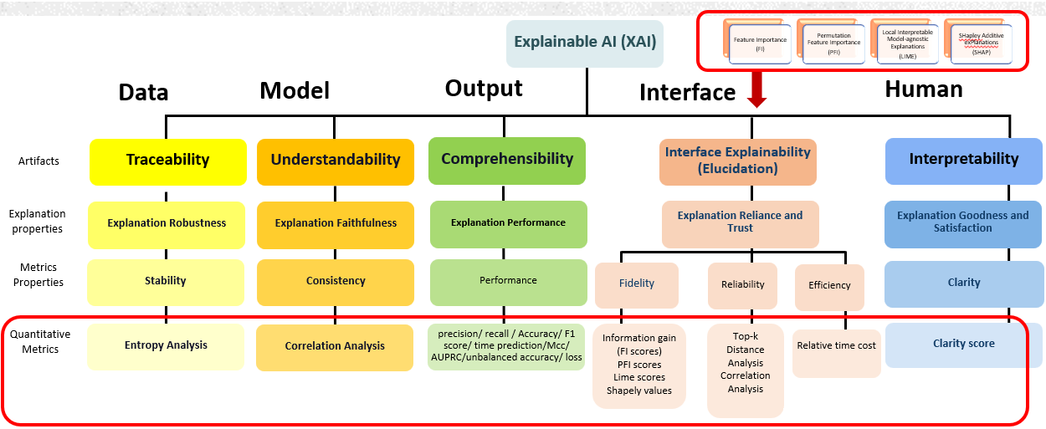
Thank You!
Any Questions?
abou-rida.amani@epita.com
Notes:
Thank you all for your attention throughout my presentation. I hope you found it informative.
Now, I would be happy to take any questions you may have.

