Slide 1
Towards attack detection in traffic data based on spectral graph analysis
Majed Jaber, Pierre Parrend, Nicolas Boutry

Slide 2
Outline
Introduction of the team and my career
Cybersecurity and cyberattacks
A network can be modeled by a (dynamical) graph
Anomaly Detection, the State-of-the-Art
Spectral Graph Analysis, a new approach for cybersecurity
Experiments & Evaluation
Future works

Slide 3
Our team
Majed Jaber^{1,2}
Nicolas Boutry¹
Pierre Parrend^{1,2}
Ph.D. Student
Enseignant-Chercheur
Professor HDR
Laboratoire de Recherche de L’EPITA (LRE), France
ICube - Laboratoire, des sciences de l’ingénieur, de l’informatique et de l’imagerie, UMR 7357, Université de Strasbourg, CNRS, 67000, Strasbourg, France

Slide 4
Master 1 Degree in Lebanese University, Faculty of Science
Software Developer in
Latest technologies and Realtime data streaming
1st of November
PhD student
Spectral graph analysis for attack detection
July , Publication of short paper
poster presentation
in RJCIA conference
2022
2023
2018
2022
2023
2017
2018
2016
2018
2016
2018
2019
2023
2019
2023
Bachelor’s Degree in Lebanese University, Faculty of Science
3rd of March, Participation in CCE conference
Best student
presentation
award
Professional Master in Game Design and Development
Research Master in Information System and Data Intelligence

Slide 5
Communications
Title: Towards attack detection in traffic data based on spectral graph analysis
Authors: Majed Jaber, Nicolas Boutry, Pierre Parrend
Event: CC23, Complex Computational Ecosystems 2023, Baku, Azerbaïdjan
Title: Structural and spectral analysis of dynamic graphs for attack Detection
Authors: Majed Jaber, Nicolas Boutry, Pierre Parrend
Event: RJCIA, Evènement affilié à PFIA 2023, Strasbourg, France

Slide 6
Cybersecurity against attacks

Slide 7
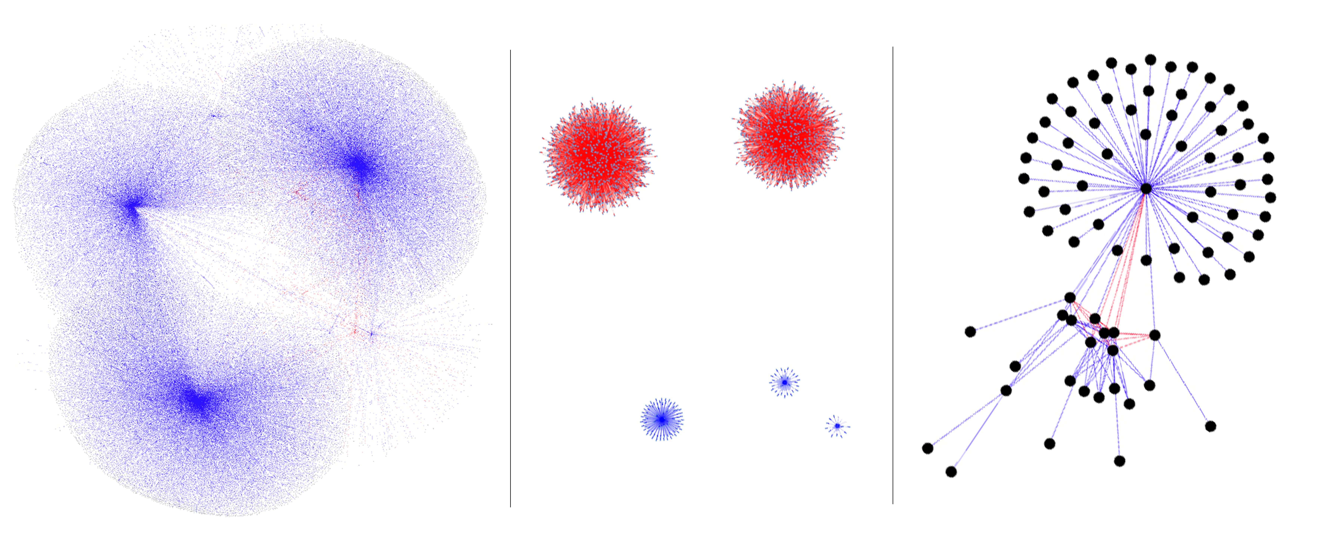
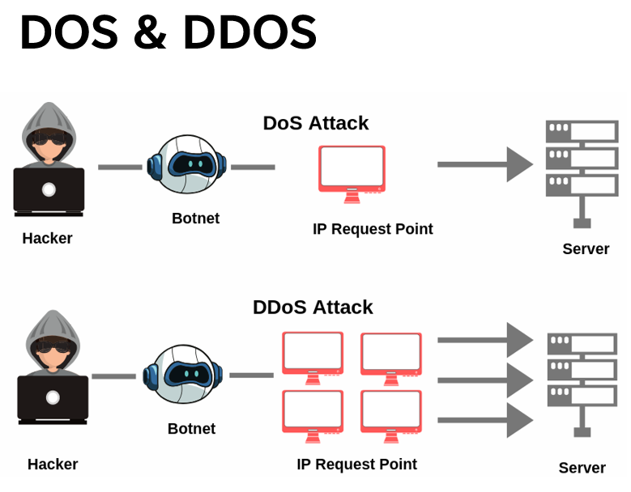
Graph represents a networks
Decompose different patterns
Identify patterns
Understand the network

Slide 8
State-of-the-Art
Statistical Approaches
ML Approaches
GCN Approaches
A real-time
network anomaly-detector (ReTiNA)
CAMLPAD model
anomalies are assigned an outlier score
ML-based techniques are supervised
algorithms
One of the best choice for graph data learning tasks
The Dynamic Graph
Neural Networks (DGNNs) are known to be an interesting tool to detect
anomalies in complex dynamic graphs
Traditional systems use elementary statistics
techniques and are often inaccurate
In network security, there are not much labeled data to train efficient classifiers

Slide 9
Why Spectral graph analysis?
B
B
B
B
A
C
A
C
C
C
A
A
A
A
D
D
D
D
D
D
100
observe
Need of Metrics
observe
Quantify a threat

Slide 10
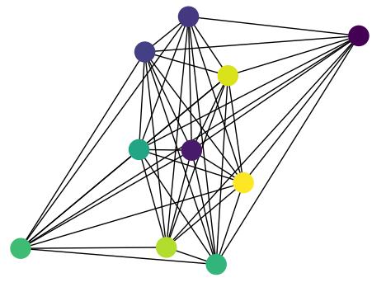
Spectral graph analysis
Studying the spectrum of the Laplacian Matrix
Mathematical
techniques
…
$${\text{λ}}_{n}$$
$${\text{λ}}_{0}$$
$${\text{λ}}_{1}$$
Analyze graph properties
Feature extraction

Slide 11
What type of matrix used?
The most commonly used matrix in spectral graph analysis is the Laplacian matrix.
Laplacian Matrix
Why Laplacian rather than other matrixes?
Better spectral properties
More robust to changes in the graph structure.
The spectrum of the Laplacian matrix are used in various applications of spectral graph analysis, such as clustering, community detection, and graph partitioning.

Slide 12
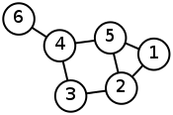
What type of matrix used?
Laplacian Matrix
The most commonly used matrix in spectral graph analysis is the Laplacian matrix.
$$L=D −A$$
Laplacian Matrix
Why Laplacian rather than other matrixes?
Better spectral properties
More robust to changes in the graph structure.
The spectrum of the Laplacian matrix are used in various applications of spectral graph analysis, such as clustering, community detection, and graph partitioning.
$$L=$$
$$−$$
$$=$$
$$A_{i,j}≔\left\{\begin{aligned}1 if i≠j & \text{and} v_{i} \sim v_{j} \\ 0 \text{otherwise}\end{aligned}\right.$$

Slide 13
What is a spectrum?
the spectrum refers to the set of eigenvalues of the Laplacian matrix.
…
$${\text{λ}}_{n}$$
$${\text{λ}}_{0}$$
$${\text{λ}}_{1}$$
Spectrum
Eigenvalues

Slide 14
Spectrum Interesting eigenvalues
Algebraic connectivity
Largest eigenvalues
Zero eigenvalues
Zero eigenvalues
Algebraic connectivity
Largest eigenvalues
.
.
.

Slide 15
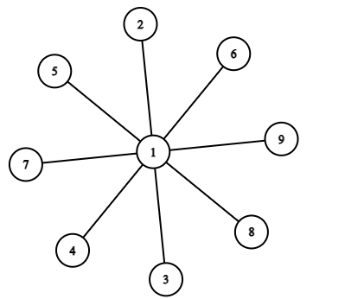
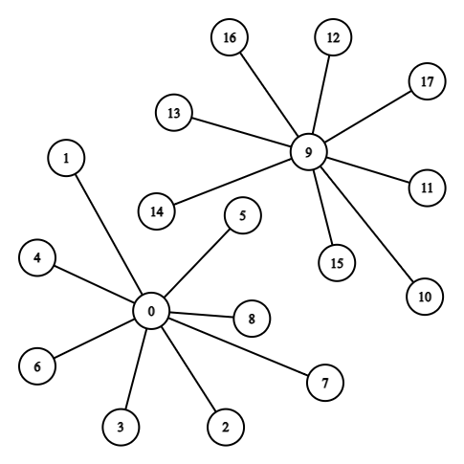
Spectrum Interesting EV - Example
0 1 1 1 1 1 1 1 7
0 0 1 1 1 1 1 1 1 1 1 1 1 1 1 1 7 7

Slide 16
Research Question
How can we benefit from spectral graph analysis to identify and detect cyberattacks over the network?
Spectral
Graph
Analysis

Slide 17
Methodology
…
Weighted edge
Where w~10 normal
W>10 suspicious
N-star graphs
…
…
…
…
Evolution 1
Evolution 2
Evolution n
$$L_{g}$$
$$L_{g}$$
$$L_{g}$$
$$Λ_{L}$$
$$Λ_{L}$$
$$Λ_{L}$$
$${\text{µ}}_{1 }{,\text{µ}}_{2}, {\text{µ}}_{3}, {\text{µ}}_{4}$$
$${\text{µ}}_{1 }{,\text{µ}}_{2}, {\text{µ}}_{3}, {\text{µ}}_{4}$$
$${\text{µ}}_{1 }{,\text{µ}}_{2}, {\text{µ}}_{3}, {\text{µ}}_{4}$$

Slide 18
Dynamic Metrics
Metric 1
Connectedness
Increases when interconnections occur in the network.
Metric 2
Flooding
This metric is influenced by the occurrence of connections as well as the weight of those connections.
Metric 3
Wiringness
It always increases when connections occur and its slope across time depends on the packets sizes.
Metric 4
Asymmetry
It corresponds to the number of variations of Λ(t) and the symmetry of the graph

Slide 19
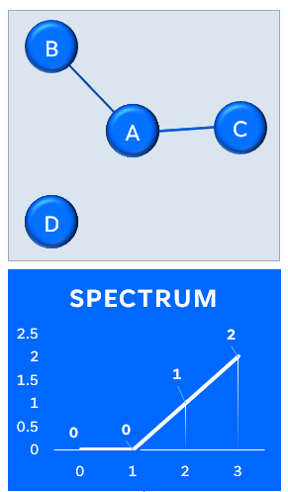
Metric 1 - Connectedness
number of zeros in the spectrum.
$$\lim_{Ζ(t)→∞}{μ_{1}=e^{−1}}$$
$$\lim_{Ζ(t)→1}{μ_{1}=1}$$

Slide 20
Metric 2 - Flooding
B
C
A
F
$𝒩$is the number of servers/hubs
E
H
D
G
Connections/Flooding
J
Results in
I
K
L
Metric 2

Slide 21
Metric 3 - Wiringness
B
C
A
F
$𝒩$is the number of servers/hubs
E
H
D
100
G
pkts/bytes
J
Results in
I
K
L
Metric 3

Slide 22
Metric 4 - Asymmetry
B
F
C
A
E
H
with ε = 10⁻¹²
D
G
Identical patterns/symmetry
B
F
C
Results in
A
E
H
Metric 4
D
G

Slide 23
Implementation and datasets
Ton IoT | Healthcare IoT | Botnet IoT

Slide 24
Attack analysis
Botnet IoT dataset
Ton IoT dataset
IoT Healthcare Security Dataset

Slide 25
Network patterns – Star graphs
Star
Star
Star

Slide 26
Experiments – Scenario 1 – Attack behavior
1
3
2
4

Slide 27
Experiments – Scenario 2 – Normal behavior
1
3
2
4

Slide 28
Experiments Evaluation
250,000
.
.
.
200

Slide 29
Metrics over real dataset
Detect attacks
Apply metrics on dataset
$${\text{µ}}_{1 }{,\text{µ}}_{2}, {\text{µ}}_{3}, {\text{µ}}_{4}$$
Botnet dataset

Slide 30
Challenges over real datasets
stime saddr daddr pkts label
576923 1526344032 192.168.100.46 192.168.100.5 59452 0
576917 1526344032 192.168.100.46 192.168.100.5 30157 1
576916 1526344032 192.168.100.46 192.168.100.5 29726 0
576921 1526344032 192.168.100.3 13.55.154.73 3018 0
576884 1526344121 192.168.100.1 192.168.100.3 4 0
Evolution 1
Evolution 2
…
Evolution n
Evolutions

Slide 31
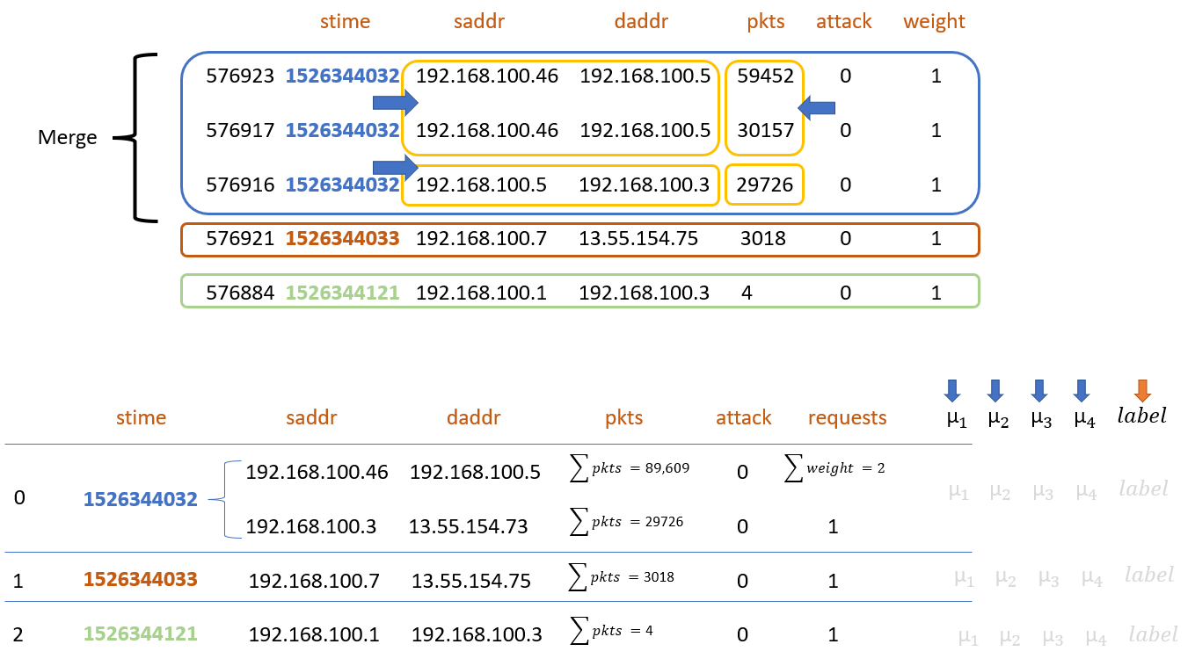
From dataset to timeseries

Slide 32
Classification methods
Evolution 1
Evolution 2
…
Evolution n
$${\text{µ}}_{1 }{,\text{µ}}_{2}, {\text{µ}}_{3}, {\text{µ}}_{4}$$
$${\text{µ}}_{1 }{,\text{µ}}_{2}, {\text{µ}}_{3}, {\text{µ}}_{4}$$
…
$${\text{µ}}_{1 }{,\text{µ}}_{2}, {\text{µ}}_{3}, {\text{µ}}_{4}$$
Evolutions
Calculate Metrics
Apply Classification Methods
Random Forest
Decision Tree
MLP
XGBoost
SVM

Slide 33
Methodology
$${ts}_{0}$$
$${ts}_{1}$$
$${ts}_{2}$$
$${ts}_{3}$$
$${ts}_{4}$$
$${ts}_{5}$$
$${ts}_{6}$$
$${ts}_{7}$$
$${ts}_{8}$$
$${ts}_{9}$$
$${ts}_{10}$$
$${ts}_{11}$$
$${ts}_{12}$$
$${ts}_{13}$$
$${ts}_{14}$$
$${ts}_{15}$$
$${ts}_{16}$$
$${ts}_{17}$$
$${ts}_{18}$$
$${ts}_{19}$$
$${ts}_{20}$$
$${ts}_{21}$$
$${ts}_{22}$$
$$t_{i }>9$$
$$t_{0}$$
$$1min$$
$${ts}_{10}$$
$${ts}_{5}$$
$${\text{µ}}_{1 }$$
$${\text{µ}}_{2 }$$
$${\text{µ}}_{3 }$$
$${\text{µ}}_{4 }$$
$${\text{µ}}_{1 }$$
$${\text{µ}}_{2 }$$
$${\text{µ}}_{3 }$$
$${\text{µ}}_{4 }$$
$$normal$$
$$t_{1}$$
$$1min$$
$${ts}_{11}$$
$${ts}_{6}$$
$${\text{µ}}_{1 }$$
$${\text{µ}}_{2 }$$
$${\text{µ}}_{3 }$$
$${\text{µ}}_{4 }$$
$${\text{µ}}_{1 }$$
$${\text{µ}}_{2 }$$
$${\text{µ}}_{3 }$$
$${\text{µ}}_{4 }$$
$$normal$$
$${ts}_{7}$$
$${ts}_{13}$$
$$t_{2}$$
$$1min$$
$${\text{µ}}_{1 }$$
$${\text{µ}}_{2 }$$
$${\text{µ}}_{3 }$$
$${\text{µ}}_{4 }$$
$${\text{µ}}_{1 }$$
$${\text{µ}}_{2 }$$
$${\text{µ}}_{3 }$$
$${\text{µ}}_{4 }$$
$$attack$$

Slide 34
Train-Test data
$${ts}_{i}$$
$${ts}_{i/2}$$
$${\text{µ}}_{1 }$$
$${\text{µ}}_{2 }$$
$${\text{µ}}_{3 }$$
$${\text{µ}}_{4 }$$
$${\text{µ}}_{1 }$$
$${\text{µ}}_{2 }$$
$${\text{µ}}_{3 }$$
$${\text{µ}}_{4 }$$
$$attack$$
t1_m1 | t1_m2 | t1_m3 | t1_m4 | t2_m1 | t2_m2 | t2_m3 | t2_m4 | label
… | … | … | … | … | … | … | … | 1

Slide 35
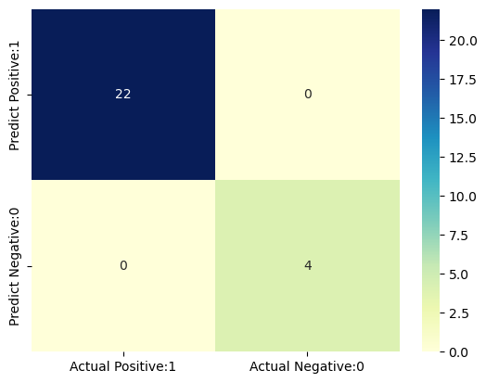
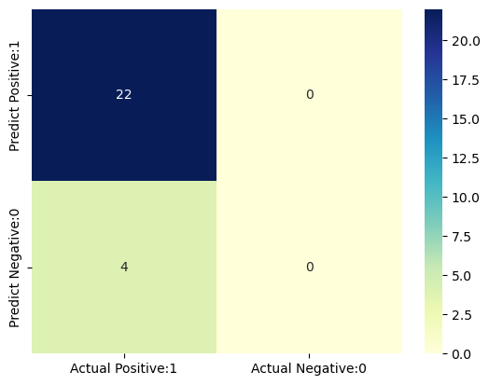
Current results revealed
Random Forest
Decision Tree
MLP
SVM

Slide 36
Achieved results
Over Star graph patterns
Metrics
Were able to detect attacks
DOS
DDOS

Slide 37
Coming work
Apply XGBoost classification for metrics data frame and compare it to other
classification methods.
Reduce the time window of each evolution to less than 10 timestamps.
Apply RBF for SVM kernels rather than linear classification.
Try different combinations of metrics to detect which metric mainly affect the
classification decisions.
Understand the classification criteria done using XAI for different classification methods.
Generate new metrics to detect new patterns, since the current one mainly proposed to detect star graph patterns.

Slide 38
Coming work – k partite graphs
K-partite graphs
Star graphs

Slide 39
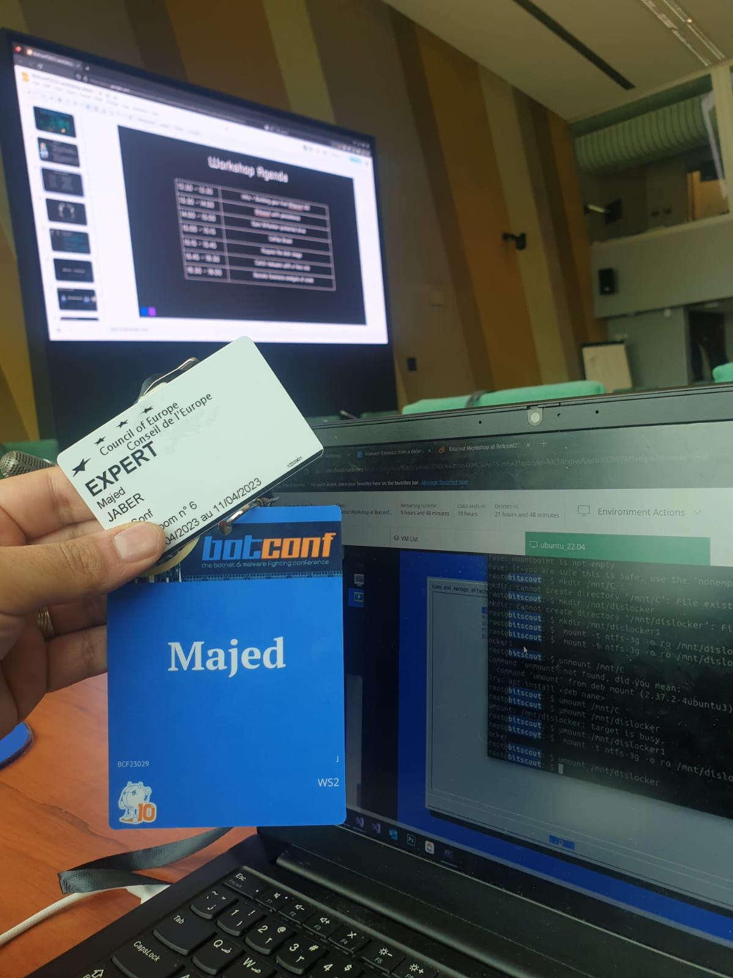
Events
BotConf23, Strasbourg
Ressi23, Neuvy-sur-Barangeon

Slide 40
Teaching
Introduction to
cryptography
Spring 2023 - Finished
Summer 2023 - Preparing

Slide 41
Thank you
Majed Jaber majed.jaber@epita.fr
Nicolas Boutry nicolas.Boutry@epita.fr
Pierre Parrend pierre.parrend@epita.fr

Slide 42
Any Questions

